Slide 1



6
C

Slide 2



Slide 3


Slide 4


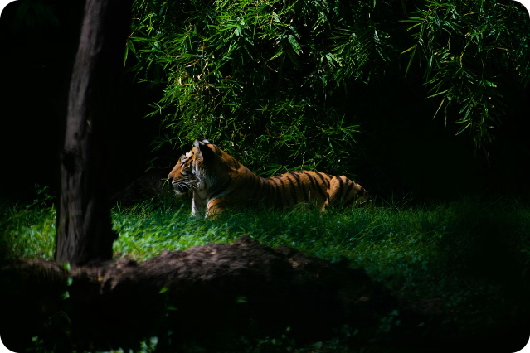
Save the Tigers
Tigers are majestic creatures that are vital to the balance of ecosystems. Tragically, their populations continue to decline due to factors like poaching and habitat loss. We must act now to protect these magnificent animals for future generations.

Slide 5

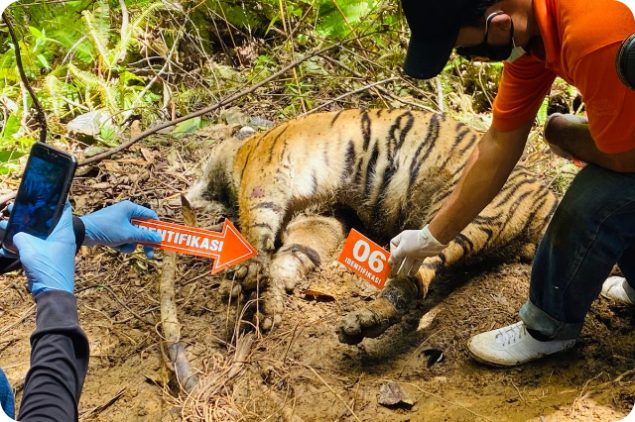
A Mother's Tragic End
1
Senseless Killing
A mother tiger was ruthlessly shot and killed by a shooter, leaving behind three vulnerable cubs.
2
Devastating Loss
The death of this tigress robs the wild of a vital breeding female, further jeopardizing the future of the species.
3
Orphaned Cubs
The three young cubs now face an uncertain future, having lost the care and protection of their mother.

Slide 6

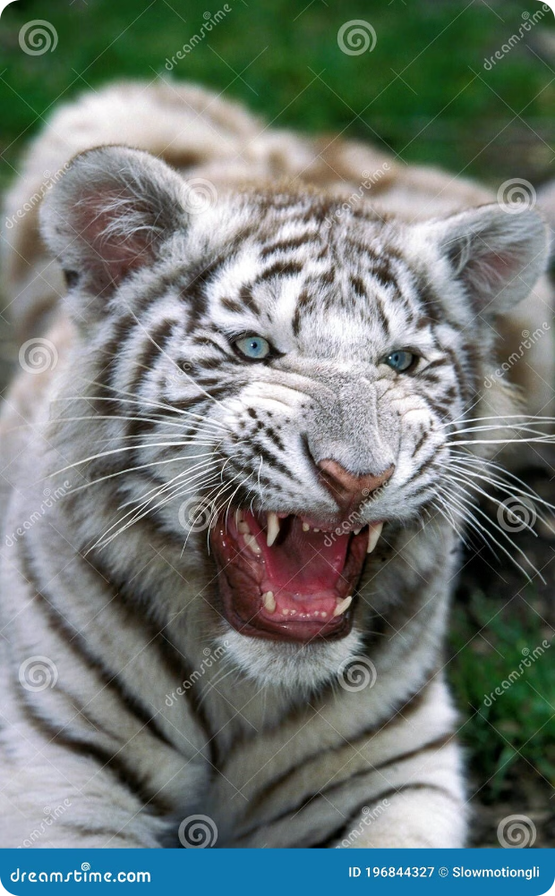
The Cubs' Cry
Heartbroken Pleas
The three helpless cubs cry out, asking "Why did you do this?" in their grief and desperation.
Innocent Victims
The cubs did not ask for their mother's life to be taken. They are the innocent victims of senseless poaching.
A Vulnerable Future
Without their mother's care, the cubs' chances of survival in the wild are greatly diminished.

Slide 7

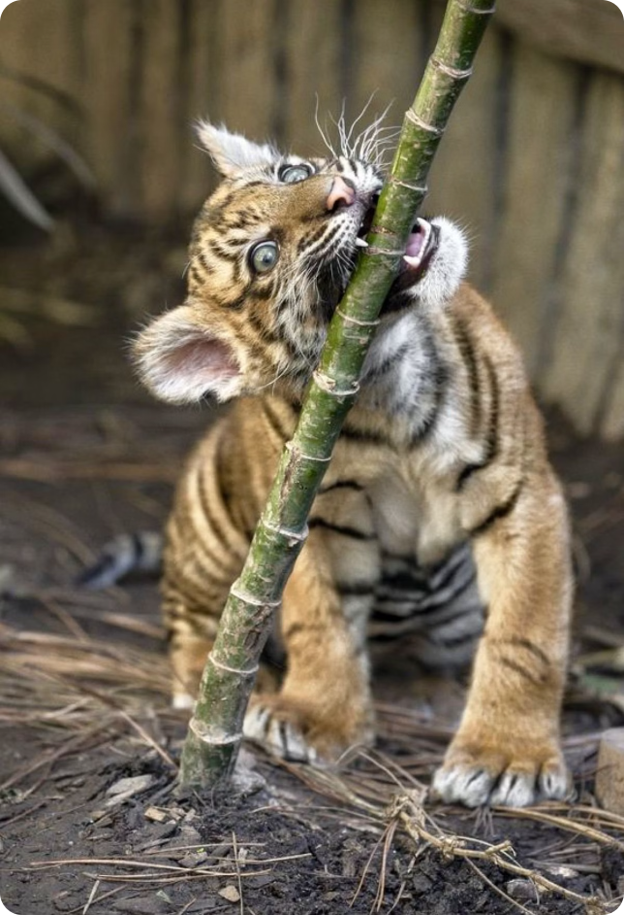



A Plea for Mercy
Unanswered Cries
The cubs' desperate pleas echo through the forest, but their cries fall on deaf ears.
Undeserved Suffering
These innocent animals did not deserve to be robbed of their mother and left to an uncertain fate.
A Cry for Help
Their only hope lies in the compassion of those who can intervene and ensure their protection.

Slide 8
A Just Request
A Simple Wish
Inherent Right
A Shared Responsibility
The cubs' plaintive cry echoes a simple truth: "We did not ask for anything more."
Tigers have an inherent right to live freely and thrive in their natural habitats.
It is our duty as stewards of the Earth to ensure the survival of these magnificent creatures.

Slide 9
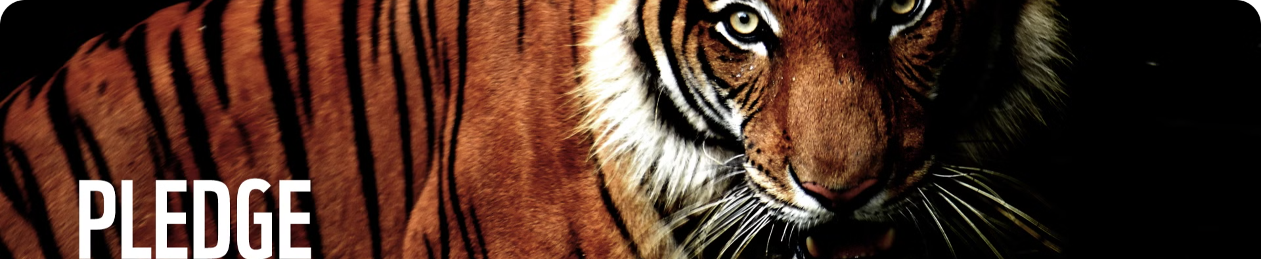
The Crucial Role of Conservation
1
Endangered Status
2
Ecological Importance
3
Conservation Efforts
Tigers are classified as endangered, with their populations facing threats from habitat loss and poaching.
Tigers are keystone species, playing a vital role in maintaining the balance of their ecosystems.
Effective conservation strategies are crucial to protect tigers and ensure their long-term survival.

Slide 10

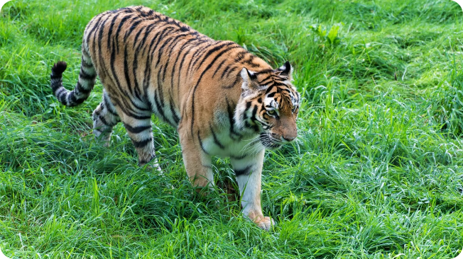
The Impact of Poaching
1
Devastating Decline
Poaching has caused a significant decline in tiger populations worldwide, with some subspecies now extinct.
2
Lucrative Illegal Trade
The illegal trade in tiger parts, such as bones and skins, continues to drive poaching and threaten the species.
3
Urgent Need for Action
Strengthening anti-poaching measures and addressing the demand for tiger products is crucial to protect this iconic animal.

Slide 11


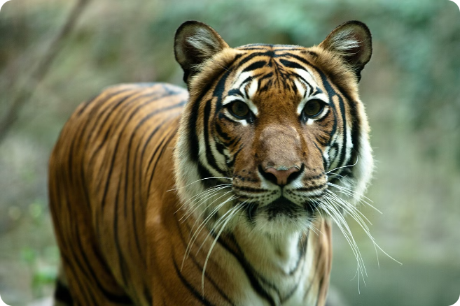


Safeguarding Tigers
Strengthened Enforcement
Increased patrols and stricter penalties for poaching can deter illegal activities.
Habitat Preservation
Protecting and restoring tiger habitats is essential for their long-term survival.
Community Involvement
Engaging local communities in conservation efforts can help reduce human-tiger conflicts.

Slide 12
How You Can Help
Donate
Advocate
Volunteer
Support organizations working to protect tigers and their habitats.
Raise awareness and speak out against illegal poaching and wildlife trafficking.
Participate in conservation efforts and contribute your time and skills.

